Slide 1
Advanced Angular
Building Re-usable Components
Lecture 3
By James(Jin) Wang
10/05/2019

Slide 2
Outline
Pass data
Raise custom events
Apply styles
Shadow DOM
View encapsulation

Slide 3
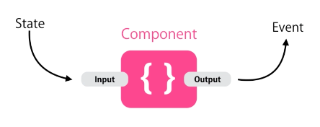
Pass data
  Component API:

Slide 4
Pass data
  Input Properties:
  add: <app-favorite [isFav]="post.isFav"></app-favorite>

Slide 5
Pass data
  Aliasing Input Properties:
  add: @Input('is-fav') isFav: boolean;

Slide 6
Pass data
  Output Properties:
  add: @Output() change = new EventEmitter();
  add:
  toggleFav() {
  this.isFav = !this.isFav;
  this.change.emit();
  }

Slide 7
Raise custom Events
  Passing Event Data:
  add:
  onFavChanged(isFav) {
  console.log("Fav Changed! " + isFav);
  }
  add:
  toggleFav() {
  this.isFav = !this.isFav;
  this.change.emit(this.isFav);
  }

Slide 8
Raise custom Events
  Passing Event Data using Interface:
  add:
  export interface FavChangedEventArgs {
  newVal: boolean
  }
  add:
  toggleFav() {
  this.isFav = !this.isFav;
  // this.change.emit(this.isFav);
  this.change.emit({newVal: this.isFav});
  }

Slide 9
Raise custom Events
  Aliasing Output Properties:
  add:
  @Output('on-change') change = new EventEmitter();

Slide 10
Summary

